Slide 1
Suresh Gyan Vihar University
Hackathon Project Presentation
Niru Kumar ( 2245909 ) – 3rd
Anwar Alam ( 100846 ) – 4th
Aditya Prakash ( 101573 ) – 4th
Ankur Kumar Patel ( 2246400 ) – 3rd
Chandan Kumar ( 2245944 ) – 3rd

Slide 2
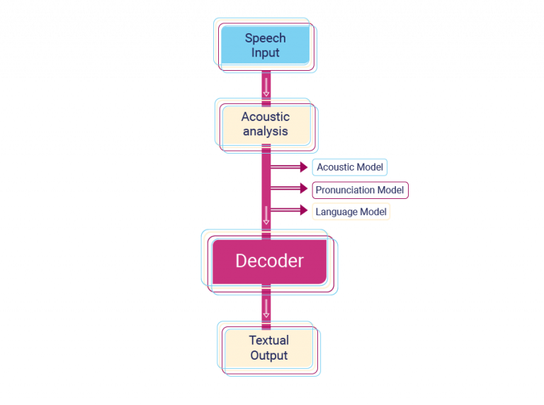
Introduction to Voice Assistants
Voice assistants are AI-driven software applications that respond to voice commands.
They can perform tasks, provide information, and improve user interaction with technology.
Understanding how to create a voice assistant using Python can enhance programming skills and knowledge of AI.

Slide 3
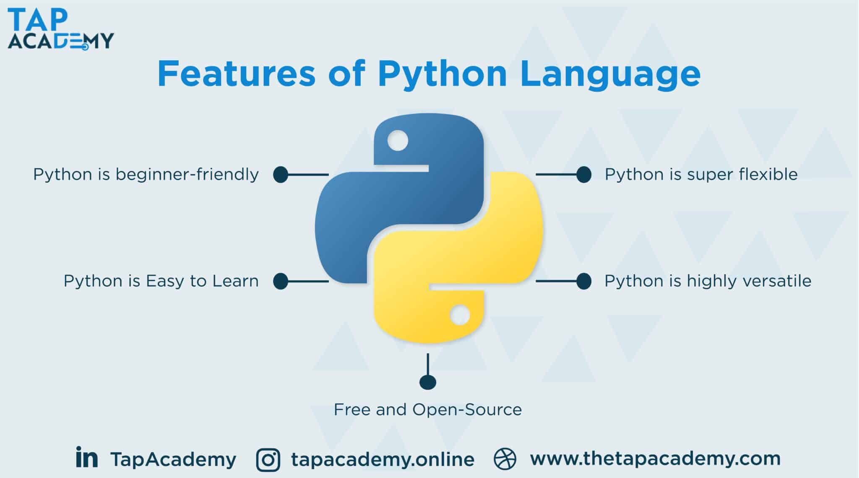
Overview of Python for Voice Assistants
Python is a versatile programming language that is widely used in AI and machine learning.
Libraries such as SpeechRecognition and pyttsx3 make building voice assistants accessible.
Python's simplicity allows developers to focus on functionality rather than complex syntax.

Slide 4
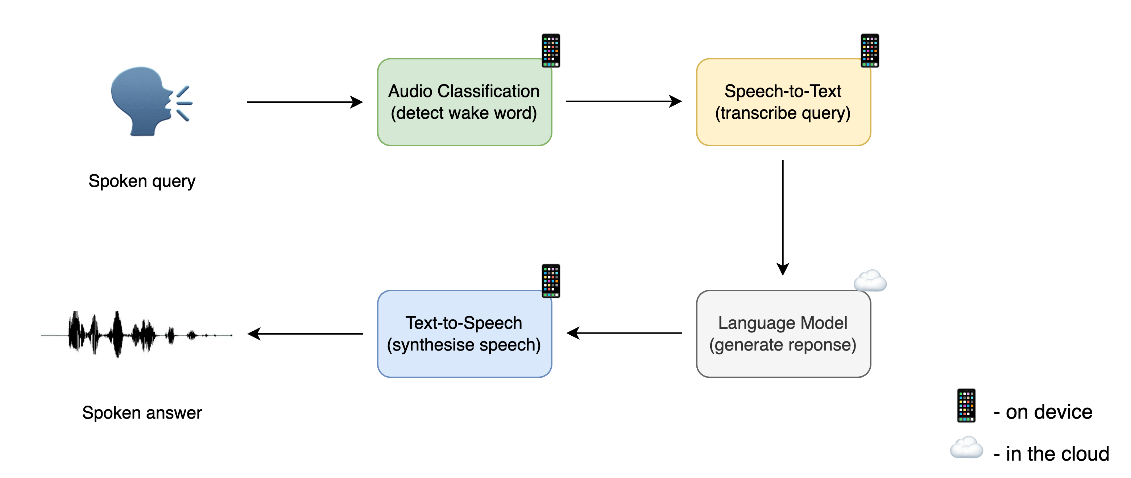
Key Components of a Voice Assistant
A voice assistant typically includes speech recognition, text-to-speech, and natural language processing.
These components work together to interpret user commands and respond appropriately.
Understanding each component is crucial for building a functional voice assistant.

Slide 5
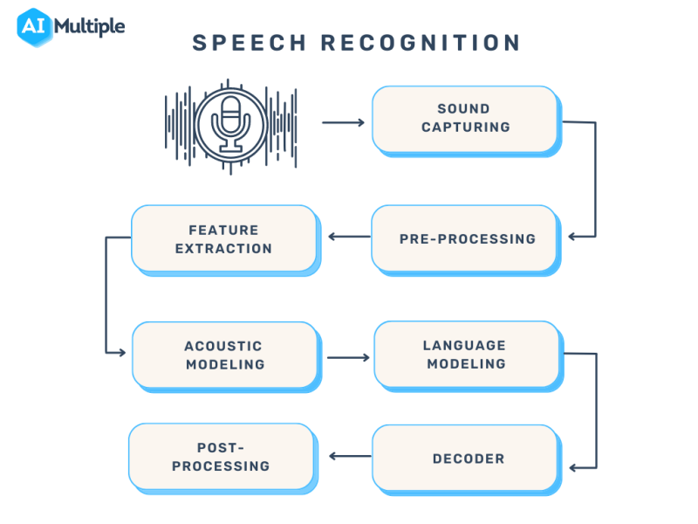
Speech Recognition
Speech recognition converts spoken language into text for processing.
The SpeechRecognition library supports various engines and APIs for accurate speech capture.
It is essential for enabling the voice assistant to understand user commands.

Slide 6
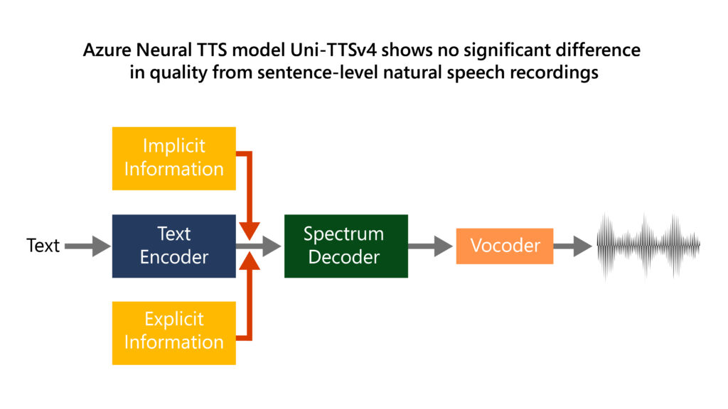
Text-to-Speech (TTS)
Text-to-speech technology allows the voice assistant to communicate back to the user.
Libraries like pyttsx3 provide easy-to-use interfaces for implementing TTS.
A good TTS system enhances user experience by providing clear and natural-sounding responses.

Slide 7
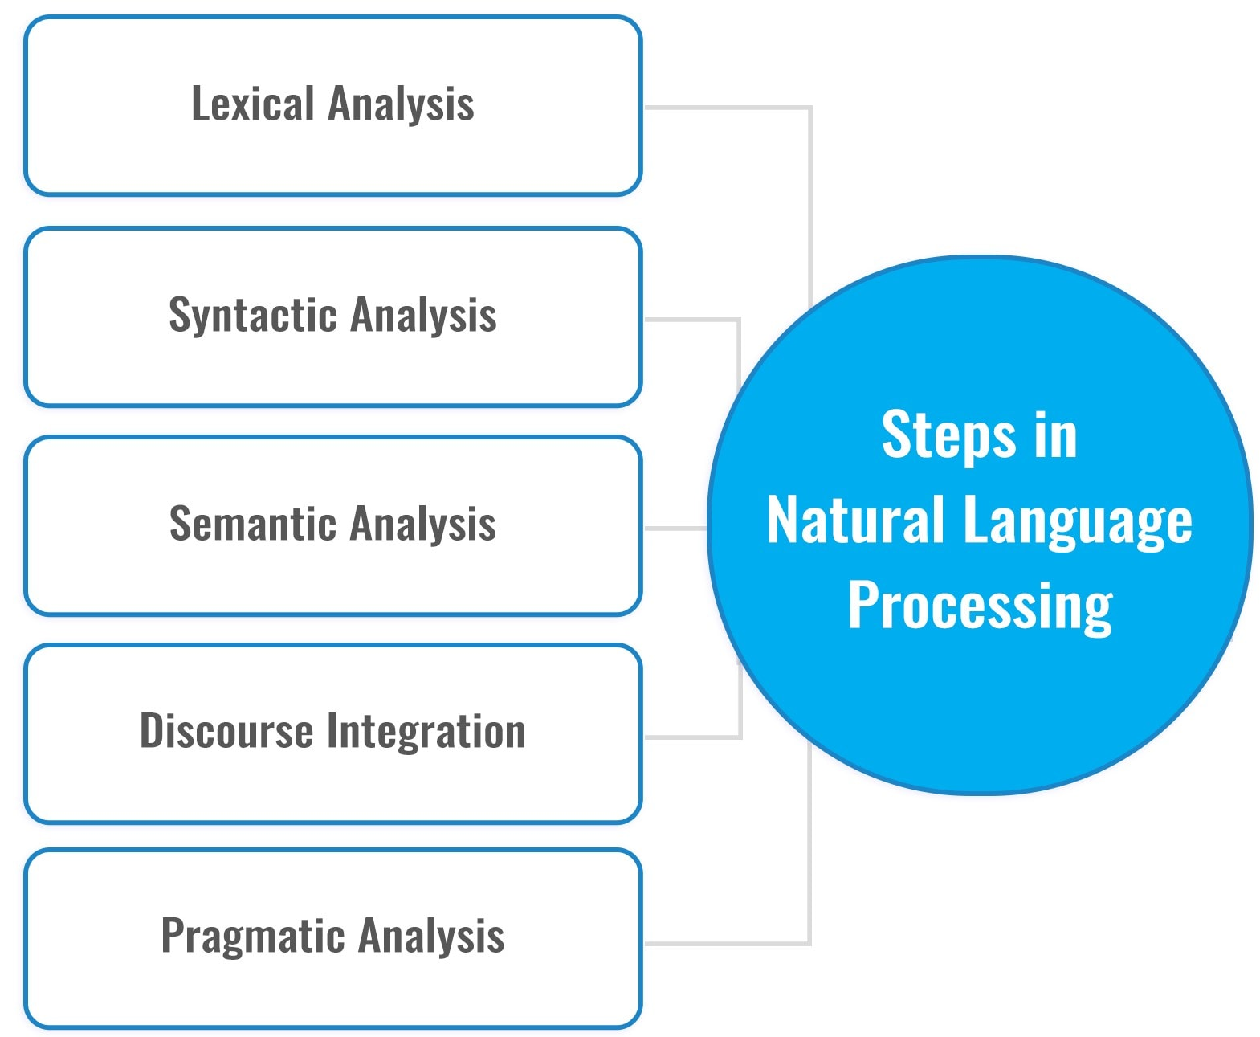
Natural Language Processing (NLP)
NLP enables the voice assistant to understand and interpret human language.
Libraries such as NLTK and spaCy can be utilized for parsing and analyzing text.
Effective NLP is crucial for the assistant to respond accurately to user queries.

Slide 8
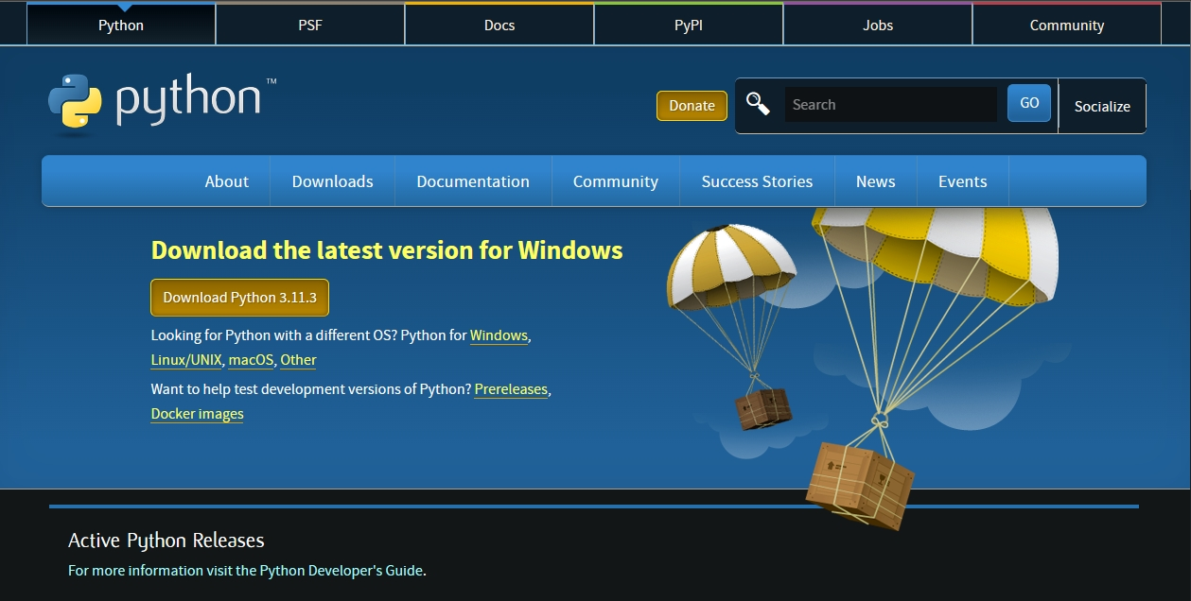
Setting Up Your Environment
Start by installing Python and necessary libraries through pip.
Create a virtual environment to manage dependencies effectively.
Ensure that your microphone and speakers are properly configured for testing.

Slide 9
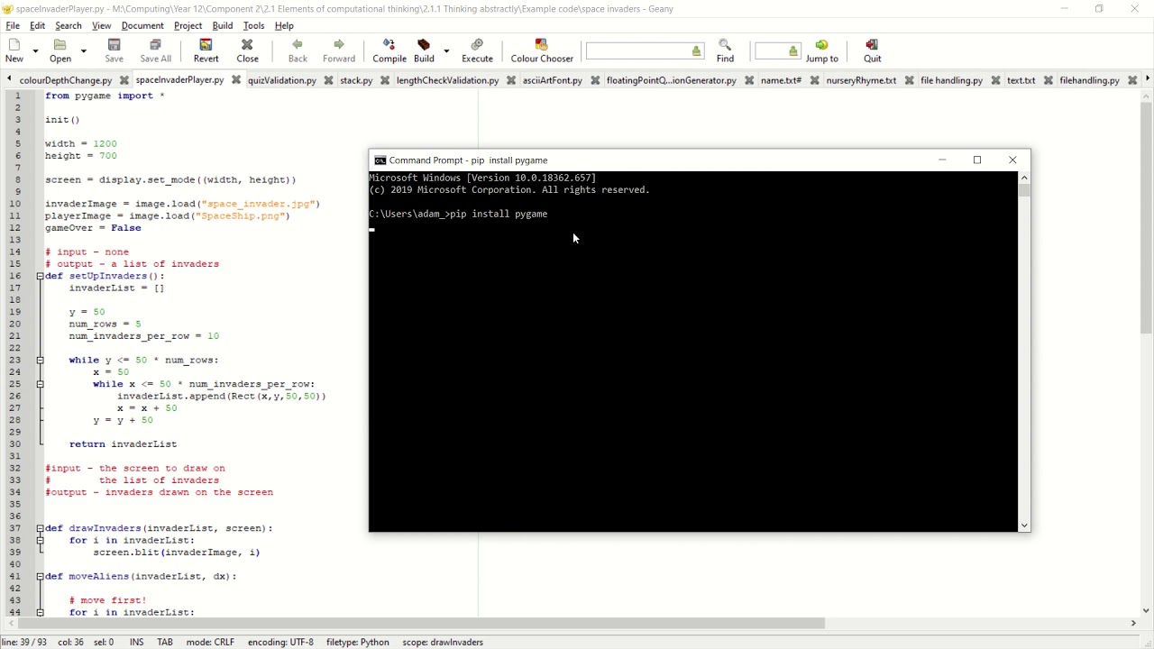
Installing Required Libraries
Use pip to install libraries like SpeechRecognition and pyttsx3.
Additional libraries may include pyaudio for capturing audio input.
Check for compatibility issues to avoid runtime errors.

Slide 10
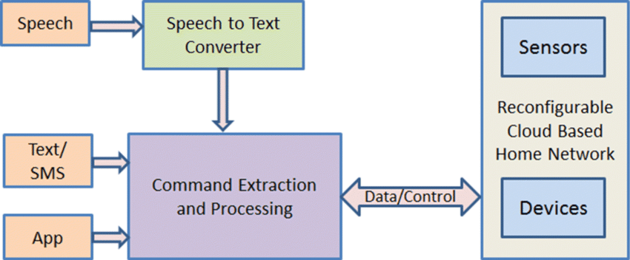
Basic Structure of a Voice Assistant
A simple voice assistant can be structured with initialization, command listening, and responding functions.
Implement a loop to continuously listen for user input.
The assistant should process commands and provide responses in real-time.

Slide 11
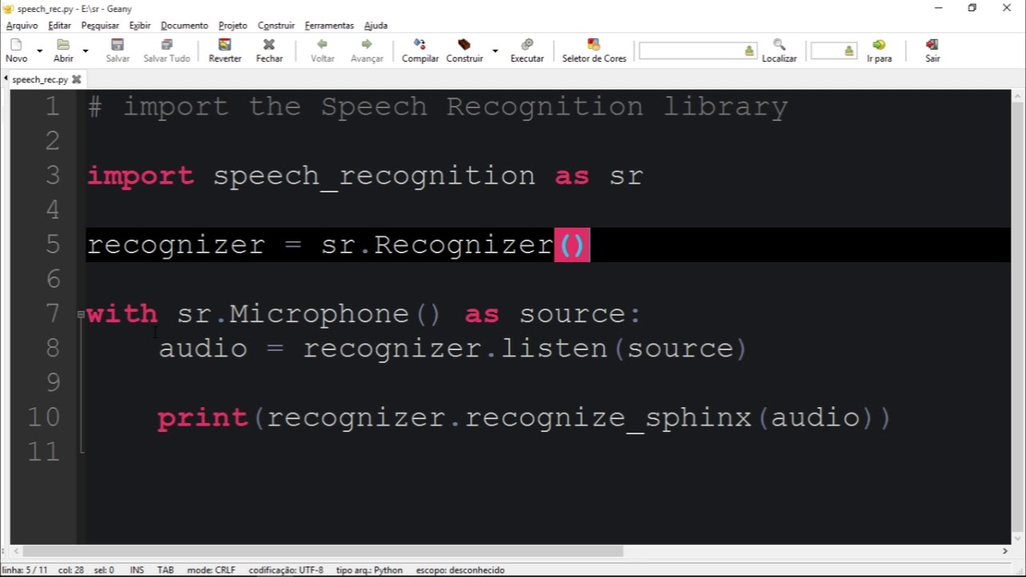
Example Code Snippet
Here is a basic example of initializing the SpeechRecognition library in Python.
It demonstrates how to capture audio and convert it to text.
This foundational code sets the stage for more complex functionalities.

Slide 12
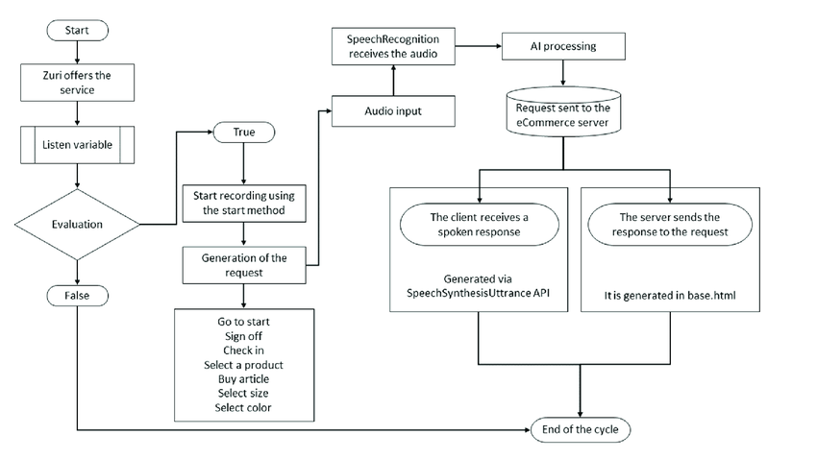
Adding Command Functionality
Define specific commands that the assistant can recognize and respond to.
Use conditional statements to determine the appropriate action for each command.
This step enhances the interactivity of the voice assistant.

Slide 13
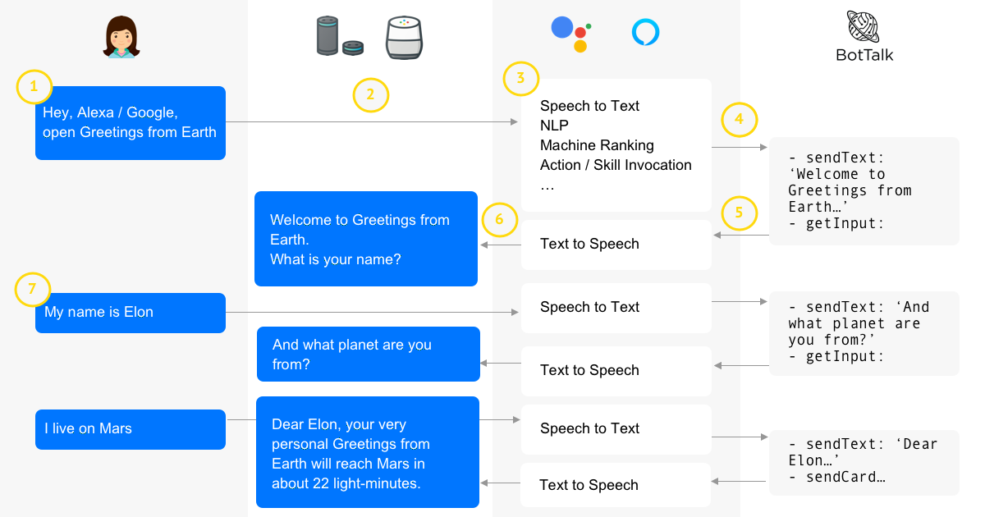
Integrating Web APIs
Voice assistants can leverage web APIs to fetch real-time information.
For example, integrating weather or news APIs can provide valuable updates to users.
This functionality expands the assistant's capabilities beyond basic commands.

Slide 14
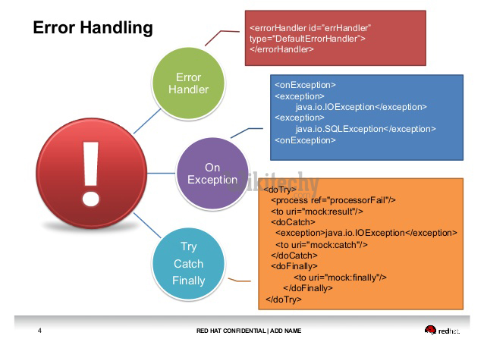
Error Handling and User Feedback
Implement error handling to manage unrecognized commands or audio input issues.
Providing feedback to users can improve the overall experience.
Use try-except blocks to gracefully handle exceptions in the code.

Slide 15
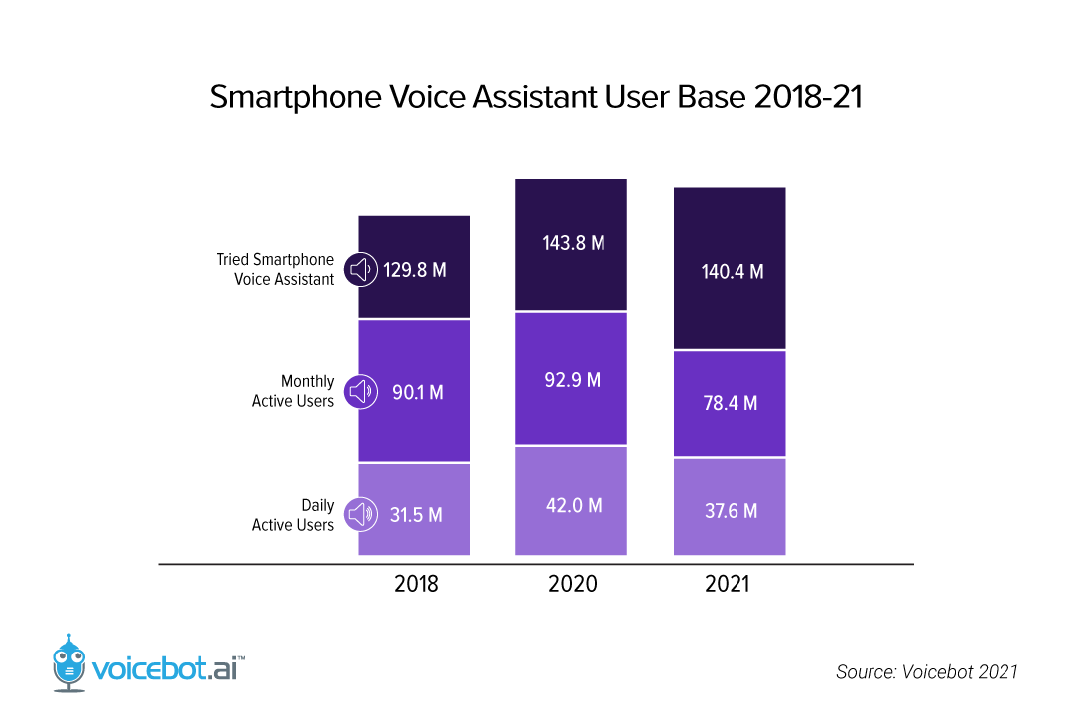
Personalization Features
Personalizing user interactions can make the voice assistant more engaging.
Store user preferences and settings for a customized experience.
This feature can include remembering names, interests, or frequently asked questions.

Slide 16
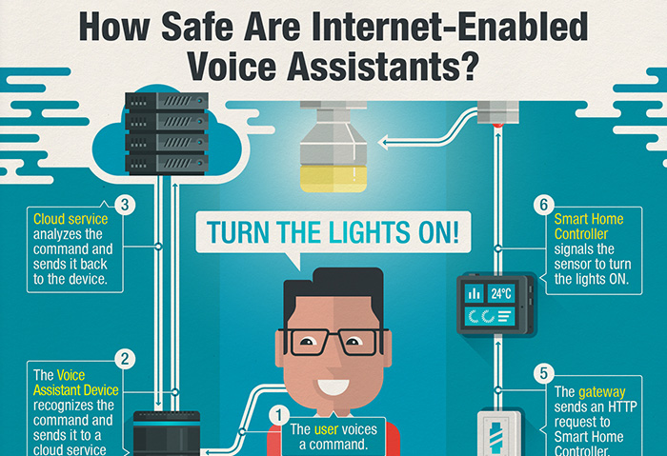
Security Considerations
Voice assistants should prioritize user privacy and data security.
Implement measures to protect sensitive information and secure API calls.
Awareness of security risks is vital when developing any voice-activated application.

Slide 17


